Slide 1

Department of Computer Science Engineering & Engineering Mini Project Presentation (KCS-554) On “ Youtube Clone“
Raj Kumar Goel Institute of Technology Ghaziabad
5th KM. STONE, DELHI-MEERUT ROAD, GHAZIABAD (U.P)-201003
Students
Anurag Kumar Sahani (2200330100058)
Aman Raj Kushwaha (2200330100037)
Adnan (2200330100026)
Under the Guidance of
Mrs. Chanchal Jayant
Mrs. Samridhi Gulati
Assistant Professor
Department of CSE

Slide 2
CONTENTS
INTRODUCTION
OBJECTIVE
LITERATURE SURVEY
METHODOLOGY
HARDWARE AND SOFTWARE USE
WORK PROGRESS
SCREENSHOTS
REFERENCES

Slide 3
INTRODUCTION
The YouTube Clone project is a simplified representation of the YouTube platform, built using HTML, CSS, and JavaScript. This project focuses on creating a functional and visually appealing interface that mimics the essential features of YouTube. It serves as a practical exercise to strengthen web development skills by implementing responsive design, interactivity, and user-centered design principles.
Key Features
Homepage Design: Includes a navigation bar, video thumbnails, and a footer.
Search Functionality: A functional search bar that filters video thumbnails based on user input.
Video Player Simulation: Clicking on a video thumbnail simulates opening a video player with a description.
Responsive Design: Ensures usability on desktops, tablets, and mobile devices.

Slide 4
OBJECTIVE
The primary objective of the YouTube Clone project is to design and develop a simplified version of the YouTube platform, focusing on the core features and functionalities using HTML, CSS, and JavaScript. This project aims to enhance the understanding of front-end development by building an interactive and visually appealing web application.
The project seeks to create a responsive user interface that adapts seamlessly across devices, ensuring a user-friendly experience. It also aims to implement basic interactivity, such as a functional search bar for filtering videos and a click-to-play simulation for video thumbnails. Through this project, developers gain hands-on experience in structuring web pages, styling layouts, and adding dynamic behavior using JavaScript.

Slide 5
METHODOLOGY
The development of the YouTube Clone project followed a systematic approach to ensure the successful completion of a functional and user-friendly web application. The methodology includes the following steps:
Requirement Analysis
Identified the core features and functionalities to replicate a simplified version of YouTube.
Defined the project scope to include interface design, interactivity, and responsiveness.
Design Phase
Wireframing: Sketched the basic layout of the homepage, including a navigation bar, video thumbnail grid, and footer.
UI/UX Design: Focused on creating a visually appealing and user-friendly interface using modern web design principles.

Slide 6
HARDWARE & SOFTWARE USE
• Operating System:
Windows, macOS, or Linux (any modern version).
• Development Tools:
Code Editor: Visual Studio Code, Sublime Text, or Atom.
Web Browser: Latest version of Chrome, Firefox, Edge, or Safari for testing.
• Technologies:
HTML5: For structuring the webpage.
CSS3: For styling and responsive design.
JavaScript (ES6): For adding interactivity and dynamic features.

Slide 7
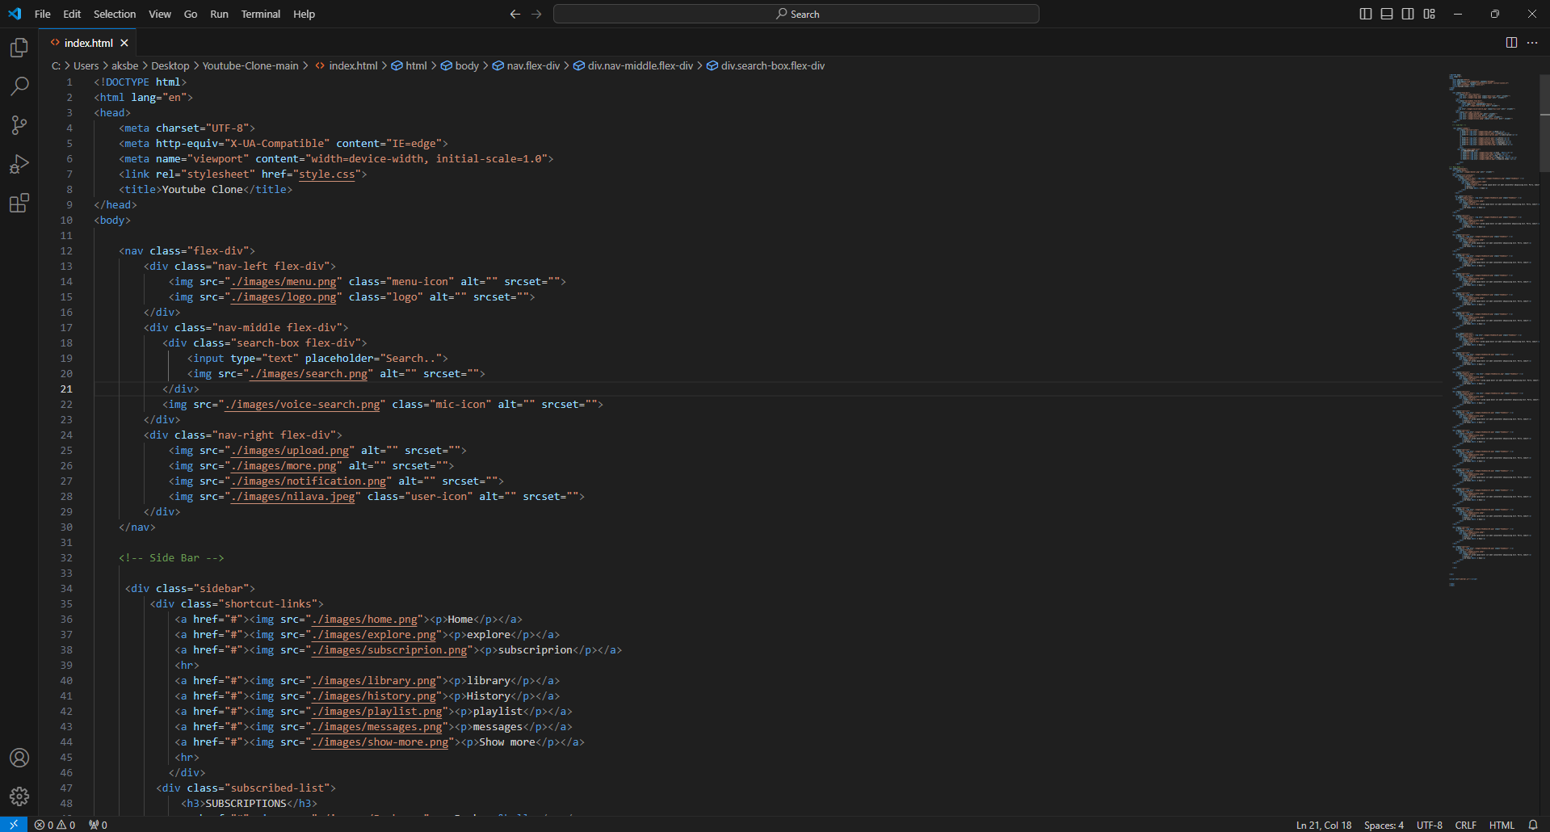
Work Progress
Screenshot of Html Code

Slide 8
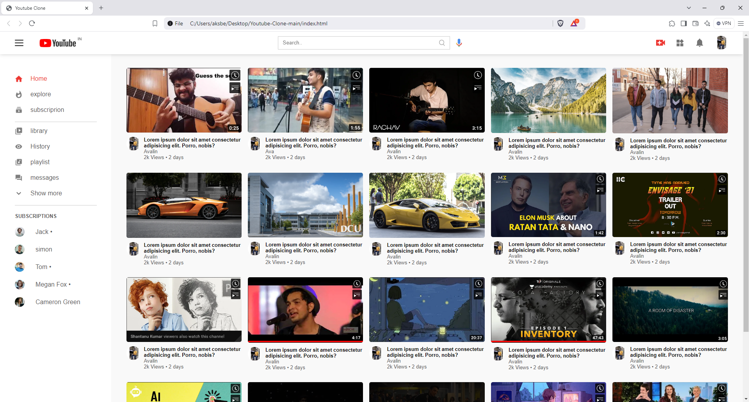
Screenshots of Project

Slide 9
References(example)
HTML and CSS References
HTML Documentation:
MDN Web Docs - HTML
W3Schools - HTML Tutorial
CSS Documentation:
MDN Web Docs - CSS
W3Schools - CSS Tutorial
JavaScript References
JavaScript Basics:
MDN Web Docs - JavaScript
W3Schools - JavaScript Tutorial
DOM Manipulation:
MDN Web Docs - DOM

